Slide 1
Introduction to emerging technology
CT060-3-3-EMTECH-Emerging Technology

Slide 2
Topic Learning Outcomes
At the end of this topic, you should be able to:
1. Develop knowledge related to the era of industrial revolution
2. Describe technological innovations that spurred industrialization.
3. Develop knowledge related to emerging technologies.
4. Evaluate Challenges of established firms.
5. Explain Disruptive technologies.
6. Examine Incumbents to a new journey.

Slide 3
Key Terminologies
Emerging technology
Evolution
Industrial revolutions
IR 4.0
Challenges
Creative Destruction

Slide 4
Industrial Revolution
The four types of industries includes;
The Primary Industry – involves getting of raw materials; e.g., mining, farming & fishing.
The Secondary Industry – involves manufacturing; e.g., making steels and cars.
The Tertiary Industry – provides a services; e.g., nursing and teaching.
The Quaternary Industry – involves research & development industries; e.g., Information technology (IT)
Notes:
1. Primary Industry
Description: This sector involves the extraction and harvesting of natural resources directly from the Earth. Activities in this industry provide the raw materials that are essential for other industries.
Examples:
Mining: Extraction of minerals, metals, and other geological materials from the Earth.
Farming: Cultivation of crops and rearing of animals for food, fiber, medicinal plants, and other products used to sustain and enhance human life.
Fishing: Harvesting fish and other aquatic organisms from oceans, rivers, and lakes.
2. Secondary Industry
Description: This sector involves transforming raw materials obtained from the primary sector into finished goods or products. It includes all manufacturing and construction activities.
Examples:
Making Steel: Processing iron ore into steel, which is then used for various applications such as construction, automotive, and manufacturing.
Car Manufacturing: Assembling various components like engines, wheels, and bodies to produce vehicles.
3. Tertiary Industry
Description: This sector provides services rather than goods. It encompasses a wide range of activities that help support the economy by offering services to businesses and individuals.
Examples:
Nursing: Providing healthcare and support to patients in hospitals, clinics, and residential care facilities.
Teaching: Educating and training individuals at schools, colleges, and universities.
4. Quaternary Industry
Description: This sector involves knowledge-based activities that focus on research, development, and information technology. It is often considered a part of the tertiary sector but is distinguished by its emphasis on intellectual services and innovation.
Examples:
Information Technology (IT): Developing software, managing databases, and providing digital solutions for various industries.
Research and Development (R&D): Conducting scientific research and developing new products or processes to advance technology and improve existing methods.
These industries are interdependent, with each playing a crucial role in the overall economic structure. The primary industry supplies raw materials to the secondary industry, which produces goods used by the tertiary industry to provide services. The quaternary industry supports innovation and technological advancements across all sectors.

Slide 5
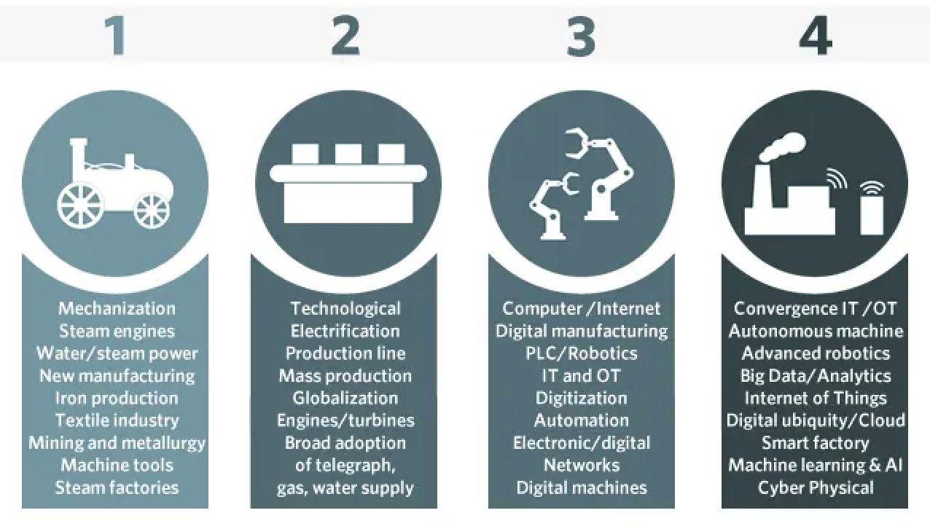
Industrial Revolution
Notes:
Industrial Revolution 1.0 (IR 1.0)
Time Period: Late 18th to early 19th century
Key Features: Mechanization, steam power, textile and iron production, railways
Impact: Increased production, urbanization, new job categories, poor working conditions
Industrial Revolution 2.0 (IR 2.0)
Time Period: Late 19th to early 20th century
Key Features: Electrification, mass production, steel and chemicals, telecommunications
Impact: Enhanced efficiency, improved living standards, global trade expansion.
Industrial Revolution 3.0 (IR 3.0)
Time Period: Late 20th century
Key Features: Automation, computers, electronics, information technology, digitalization
Impact: Automation of industries, rise of the digital economy, global connectivity.
Industrial Revolution 4.0 (IR 4.0)
Time Period: Early 21st century to present
Key Features: Cyber-physical systems, IoT, big data, AI, robotics, blockchain, advanced materials, biotechnology
Impact: Smart factories, real-time data analysis, new business models, enhanced efficiency and innovation
Each revolution marks a significant technological leap, reshaping industries, economies, and societies.

Slide 6
Emerging Technology?
Generally, the term Emerging Technology (ET) are being used to describe new technological existence.
Alternatively, Emerging Technology (ET) can also be used to reflect the continuous development of existing technology.
Emerging Technology – commonly reflects to a technology that are currently in development, or that are expected to be available within next 5 – 10 years.
Possibilities in having slight difference when used in different areas such as media, education, business, science.
Notes:
Emerging technology refers to advancements and innovations that are currently in the early stages of development, adoption, or are on the brink of becoming commercially viable. These technologies often have the potential to significantly impact various aspects of society, industry, and everyday life. Examples of emerging technologies include:
Artificial Intelligence (AI) and Machine Learning: These technologies involve creating systems that can learn from data, recognize patterns, and make decisions without human intervention.
Internet of Things (IoT): IoT refers to the network of interconnected devices and objects embedded with sensors, software, and other technologies, enabling them to collect and exchange data.
Blockchain: Blockchain is a decentralized, distributed ledger technology that securely records transactions across multiple computers, providing transparency and security.
5G Technology: The fifth generation of cellular technology promises faster data speeds, lower latency, and greater connectivity, enabling advancements in areas like autonomous vehicles, remote surgery, and augmented reality.
Quantum Computing: Quantum computing leverages the principles of quantum mechanics to perform complex computations at speeds far beyond what traditional computers can achieve, potentially revolutionizing fields such as cryptography, drug discovery, and materials science.

Slide 7
Emerging Technology?
A science-based innovation having potential in creating new industry and transforming an existing ones
Among the examples of Emerging Technologies (ET) includes:
Blockchain
Cloud Computing
Artificial Intelligence
Augmented Reality
Virtual Reality
Autonomous Cars
Intelligent Apps (iApps)
Robotic Processor Automation
More to Exists.
Notes:
Blockchain: Blockchain is a decentralized, distributed ledger technology that securely records transactions across multiple computers, providing transparency and security.
Artificial Intelligence (AI) and Machine Learning: These technologies involve creating systems that can learn from data, recognize patterns, and make decisions without human intervention.
Augmented Reality (AR) and Virtual Reality (VR): AR and VR technologies overlay digital information onto the real world or create immersive virtual environments, offering new ways to experience and interact with content.
Advanced Robotics: Robotics technologies are advancing rapidly, enabling automation in industries such as manufacturing, healthcare, and transportation.
5G Technology: The fifth generation of cellular technology promises faster data speeds, lower latency, and greater connectivity, enabling advancements in areas like autonomous vehicles, remote surgery, and augmented reality.
Quantum Computing: Quantum computing leverages the principles of quantum mechanics to perform complex computations at speeds far beyond what traditional computers can achieve, potentially revolutionizing fields such as cryptography, drug discovery, and materials science.
Biotechnology and Genomics: Advances in biotechnology, including gene editing techniques like CRISPR, are enabling breakthroughs in personalized medicine, agriculture, and environmental conservation.

Slide 8
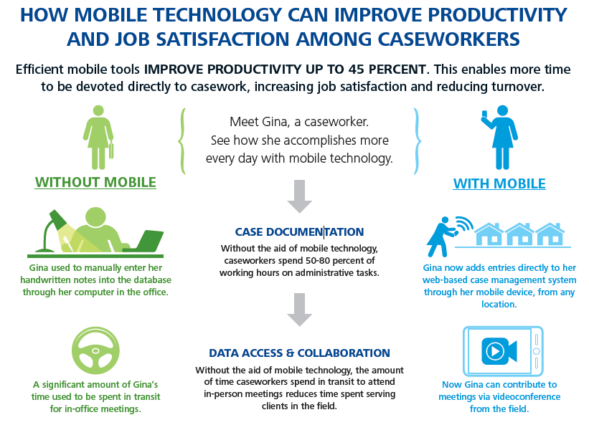
Notes:
Lets have a look into this illustration that highlights how the mobile technology actually increases the productivity and job satisfactions among employees within organization. This is being reviewed aligned with mobile technology being part of the spectrum of Emerging Technologies (constantly being upgraded and updated to accommodate to latest innovations)
Diagram here illustrates one case with two separate scenarios. One with technology usage and another is manual.
The usage of mobile technologies / tools generally has increases user productivity rate by up to 45%. It is a real serious improvement.
How Mobile Technology Can Improve Productivity and Job Satisfaction Among Caseworkers
Efficient mobile tools can improve productivity by up to 45%, allowing more time for casework, which increases job satisfaction and reduces turnover.
Without Mobile:
Caseworkers spend 50-80% of their time on administrative tasks.
Significant time is spent commuting for in-office meetings.
Example: Gina manually enters handwritten notes into the database at the office.
With Mobile:
Caseworkers can add entries directly to a web-based case management system from any location using mobile devices.
Enables participation in meetings via videoconference from the field.
Example: Gina accomplishes more every day by using mobile technology, reducing administrative burden and travel time.

Slide 9
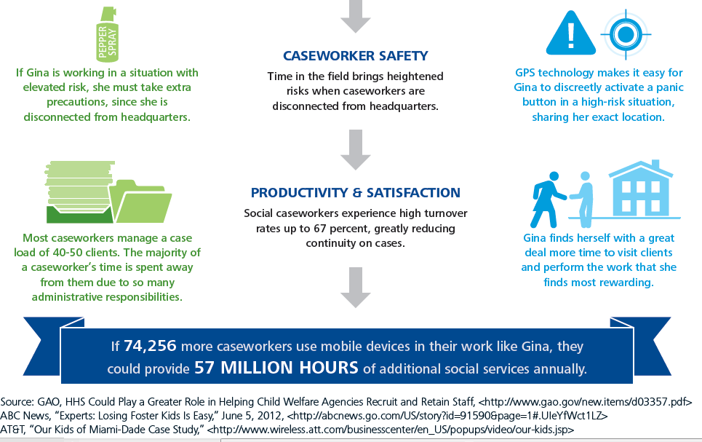
Notes:
Diagram here illustrates one case with two separate scenarios. One with technology usage and another is manual.
The usage of mobile technologies / tools generally has increases user productivity rate by up to 45%. It is a real serious improvement.
Caseworker Safety:
Without Mobile: Caseworkers face heightened risks when working in the field disconnected from headquarters.
Example: Gina must take extra precautions in risky situations.
With Mobile: GPS technology allows discreet activation of a panic button, sharing exact location in high-risk situations.
Productivity & Satisfaction:
Without Mobile: High administrative burden leads to less time with clients and high turnover rates (up to 67%), reducing case continuity.
Example: Gina's time is primarily spent on administrative tasks, managing 40-50 clients.
With Mobile: Mobile technology frees up time for caseworkers to visit clients and engage in rewarding work.
Example: Gina now has more time to visit clients and perform meaningful work.
Overall Impact:
If 74,256 more caseworkers used mobile devices, it could provide 57 million hours of additional social services annually.

Slide 10
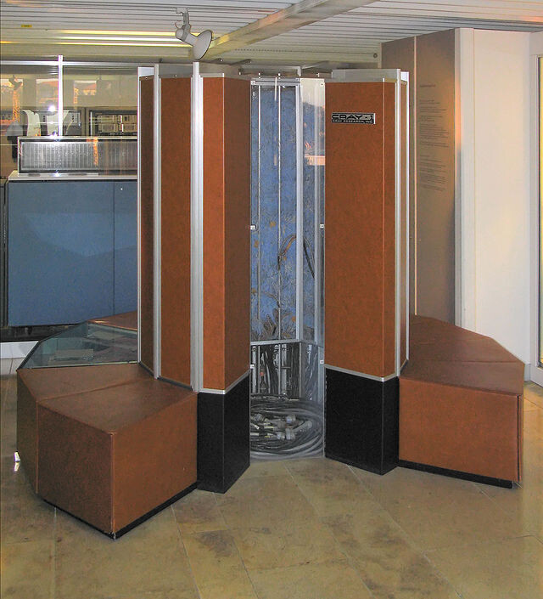
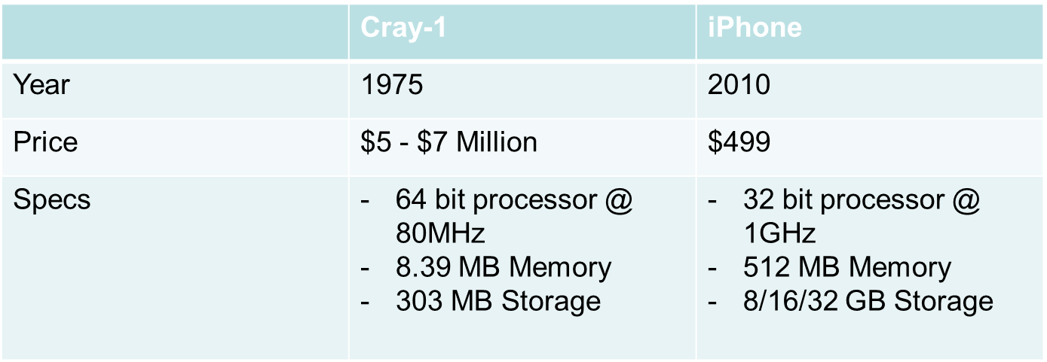
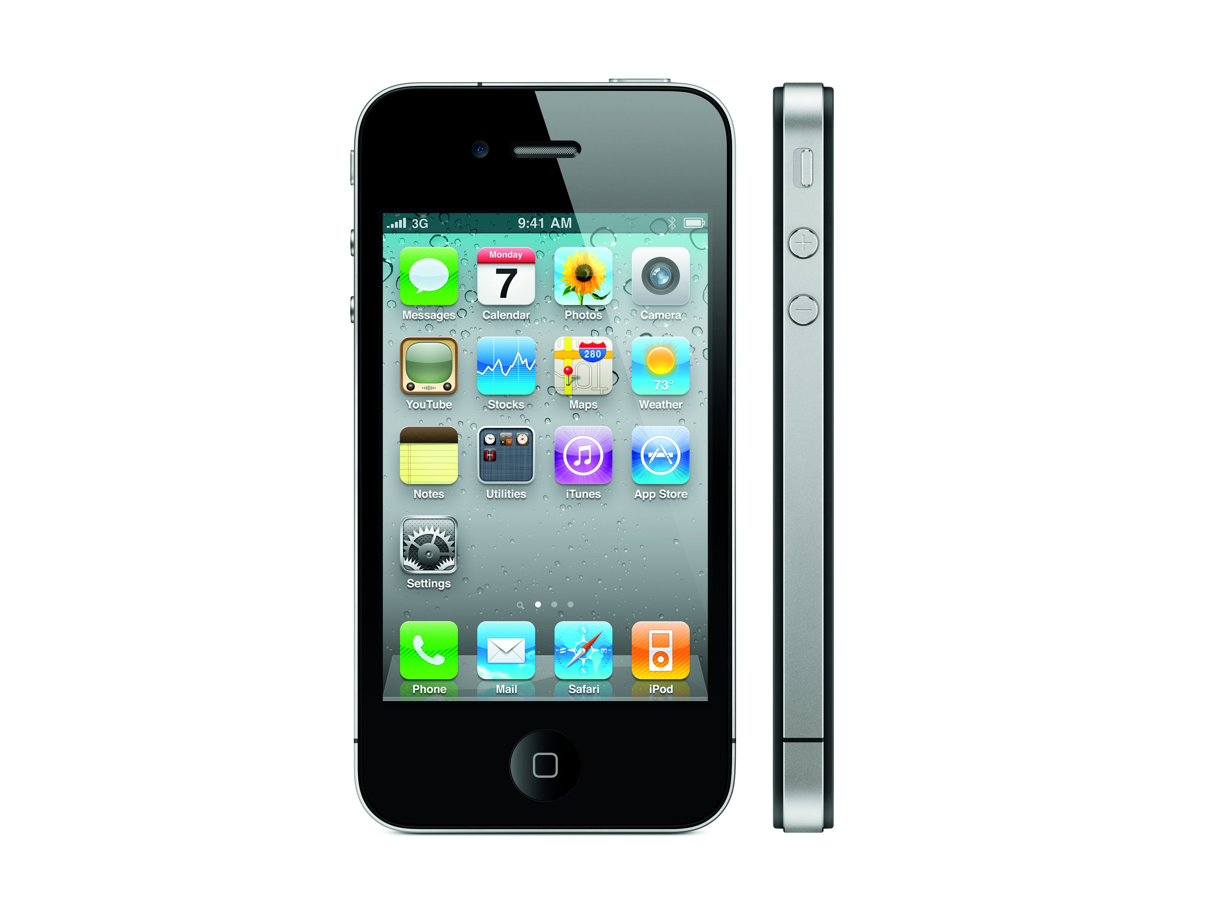
Connecting rate of improvement and reach today …
$5 million vs. $400
Price of the fastest supercomputer in 1975 and an iPhone 4 with equal performance
Notes:
A great example of emergent technology that is still relevant today, in a new form, and serving much more advancements.
A supercomputer capability are available in pocket size device and affordable price. Imagine this interesting facts.

Slide 11
Connecting rate of improvement and reach today …
300,000+ Miles driven by Google’s autonomous cars with only one accident (human error)
3x Increase in efficiency of North American gas wells between 2007 and 2011
85% Drop in cost per watt of a solar photovoltaic cell since 2000
Notes:
A great example of emergent technology that is still relevant today, in a new form, and serving much more advancements.
A supercomputer capability are available in pocket size device and affordable price. Imagine this interesting facts.
300,000+ Miles Driven by Google’s Autonomous Cars with Only One Accident (Human Error)
Description: Google’s autonomous cars, equipped with advanced sensors, AI, and machine learning algorithms, have driven over 300,000 miles. During this extensive testing period, they experienced only one accident, which was attributed to human error rather than the autonomous technology itself.
Impact: This demonstrates the potential for autonomous vehicles to significantly reduce traffic accidents, improve road safety, and reduce human error, which is a major cause of accidents. The technology promises safer transportation systems and can potentially reduce fatalities and injuries on the road.
3x Increase in Efficiency of North American Gas Wells Between 2007 and 2011
Description: Between 2007 and 2011, there was a threefold increase in the efficiency of gas wells in North America. This improvement was achieved through advancements in drilling technologies, such as hydraulic fracturing (fracking), horizontal drilling, and better well design and management practices.
Impact: Increased efficiency means that gas wells can produce more natural gas with less environmental impact and lower operational costs. This contributes to energy security, reduces the need for imports, and supports economic growth in the energy sector. However, it also raises environmental concerns related to fracking and its impact on groundwater and ecosystems.
85% Drop in Cost per Watt of a Solar Photovoltaic Cell Since 2000
Description: Since 2000, the cost of solar photovoltaic (PV) cells has dropped by 85%. This dramatic decrease is due to advancements in manufacturing technologies, economies of scale, improvements in cell efficiency, and reductions in material costs.
Impact: The significant reduction in the cost of solar PV cells has made solar energy more accessible and affordable, driving the adoption of solar power globally. This has contributed to the growth of renewable energy, reduction of carbon emissions, and progress towards sustainable energy goals. Lower costs also mean that more households and businesses can install solar panels, reducing their dependence on fossil fuels and lowering energy bills.
4o

Slide 12
ET Characteristics
ET adopts a specific set of characteristics, includes;
Characteristics | Descriptions
ET Uncertainty | The uncertainty associated with ET takes several forms with un-known and unpredictable values and outcomes, such as standards and specifications (maturity), business models, price, and adoption rate uncertainties. As time passes, the ET becomes more matured and diffused and the number of adopters increases while costs drop. In contrast, ethical and social concerns might increase as ET is used in new applications
ET Network Effect | The value of an ET increases by increasing the number of ET users
ET Costs | The cost of owning the ET is high, and the cost of substituting traditional technology with the ET is high.
Unobvious ET Impact | The social and ethical impacts associated with the use of ET are unseen, unknown, or unexpected before its adoption/use or at an early stage of the ET life cycle
Notes:
Reference URL: https://www.jotmi.org/index.php/GT/article/view/art400/863
ET Uncertainty:
Description: Involves unpredictable values and outcomes related to standards, specifications, business models, prices, and adoption rates. Over time, as ET matures and gains more adopters, costs decrease. However, new ethical and social concerns may arise.
ET Network Effect:
Description: The value of an ET increases as the number of its users grows.
ET Costs:
Description: High costs associated with owning ET and the substantial expense of replacing traditional technology with ET.
Unobvious ET Impact:
Description: Social and ethical impacts of ET that are unseen, unknown, or unexpected before its adoption or at an early stage of its life cycle.

Slide 13
ET Characteristics
ET adopts a specific set of characteristics, includes;
Characteristics | Descriptions
ET Availability | ET is usually available for use in a particular context or in the country that creates or invents it.
ET’s are not usually fully investigated & researched | Most of the materials on ET are white papers and technical reports produced by the manufacturers of the ET with little scientific/aca-demic research.
Notes:
Reference URL: https://www.jotmi.org/index.php/GT/article/view/art400/863
ET Availability:
Description: ET is typically available for use in specific contexts or within the country that creates or invents it.
ETs are not usually fully investigated & researched:
Description: Most information on ET comes from white papers and technical reports by manufacturers, with limited scientific or academic research.

Slide 14
Incumbents Issues
On the wrong side of a big trend.
Attackers become champion
Afraid to hurt their core businesses.
Pressures of running a large organization
Size now gets in their way
Commitments to facilities, people, and channel partners restrict flexibility
Equity markets expect continuing earnings
Structures, capabilities, and mindsets
Start-ups valued for future earnings
Notes:
INCUMBENTS –
"Incumbents" typically refers to established companies or organizations that already operate within a particular industry or market. These companies have a significant presence, often with well-established customer bases, brand recognition, and market share. In many cases, incumbents have been operating in their respective industries for a considerable amount of time and may have a dominant position compared to newer entrants or competitors. When newer techs come into picture, these incumbents sometimes are not able to keep up with the changes.
In business, the term “incumbent” most often describes a company that holds the largest market share of a particular industry or that has been around a long time.
On the Wrong Side of a Big Trend
Description: Incumbents may find themselves aligned with outdated technologies, business models, or market trends, making it difficult to adapt to new market demands or technological advancements. This misalignment can lead to loss of market share to more agile competitors who are embracing these new trends.
Attackers Become Champions
Description: New entrants or smaller competitors often leverage innovative technologies or business models to disrupt established markets. These attackers can quickly gain market share and customer loyalty, positioning themselves as leaders in the industry, while incumbents struggle to keep up.
Afraid to Hurt Their Core Businesses
Description: Incumbent companies often hesitate to adopt new innovations or business models that might cannibalize their existing products or revenue streams. This fear of disrupting their own successful operations can prevent them from embracing necessary changes to stay competitive.
Pressures of Running a Large Organization
Description: Managing a large organization involves complex operations, hierarchical structures, and extensive regulatory compliance. These pressures can slow down decision-making processes and reduce the organization's ability to respond swiftly to market changes or innovative opportunities.
Size Now Gets in Their Way
Description: The sheer size of incumbent companies can become a disadvantage. Large organizations may face challenges in maintaining agility, quickly implementing new strategies, or fostering innovation due to bureaucratic processes and resistance to change within the organization.
Commitments to Facilities, People, and Channel Partners Restrict Flexibility
Description: Established companies often have significant investments in physical facilities, long-term contracts with employees, and commitments to channel partners. These commitments can limit their ability to pivot quickly or adapt to new market conditions, constraining their flexibility.
Equity Markets Expect Continuing Earnings
Description: Publicly traded incumbents face pressure from shareholders and equity markets to deliver consistent earnings and growth. This expectation can lead to a short-term focus, discouraging investments in innovative projects that might not yield immediate returns but are crucial for long-term success.
Structures, Capabilities, and Mindsets
Description: Existing organizational structures, established capabilities, and entrenched mindsets can hinder innovation. Incumbents may rely on traditional ways of thinking and operating, which can prevent them from exploring new ideas, adopting disruptive technologies, or fostering a culture of innovation.
Start-Ups Valued for Future Earnings
Description: Start-ups and new market entrants are often valued based on their potential for future growth and innovation, rather than current earnings. This allows them to attract investment and talent, enabling rapid development and market penetration. Incumbents, focused on maintaining current profitability, may struggle to compete with the agility and forward-looking strategies of these start-ups.
These issues collectively highlight the challenges that incumbent companies face in maintaining their market position and competitiveness in an evolving business landscape.

Slide 15
Challenges faced by companies
Coping with great uncertainty and complexity
Keeping up with accelerating speed
Developing new competencies
Notes:
Challenges Faced by Companies Relating to Emerging Technology
Coping with Great Uncertainty and Complexity
Description: Emerging technologies often come with unknowns regarding their future development, market adoption, and potential impacts. Companies must navigate uncertainties related to technological standards, regulatory environments, and market dynamics. The complexity arises from integrating new technologies into existing systems, managing data security and privacy, and understanding the broader implications for business models and industry landscapes.
Impact: This uncertainty and complexity can lead to hesitation in investment, difficulty in strategic planning, and challenges in risk management. Companies must develop flexible strategies and foster a culture that can adapt to rapid changes and unforeseen challenges.
Keeping Up with Accelerating Speed
Description: The pace of technological advancement is faster than ever, driven by continuous innovations and shorter product life cycles. Companies must keep up with the rapid development and deployment of new technologies, which requires swift decision-making, agile development processes, and the ability to quickly scale successful innovations.
Impact: Falling behind in technological advancements can result in lost competitive edge, market share, and relevance. To stay ahead, companies need to invest in R&D, maintain a strong focus on innovation, and streamline their processes to respond quickly to market opportunities and threats.
Developing New Competencies
Description: Adopting and leveraging emerging technologies often require new skills and expertise that may not be present within the current workforce. This includes technical skills related to the specific technologies, as well as competencies in data analytics, cybersecurity, and digital transformation.
Impact: The need to develop new competencies can strain existing training and development resources and may require significant investment in upskilling and reskilling employees. Companies might also need to recruit new talent or collaborate with external partners to bridge the skills gap. Failing to develop these competencies can hinder the effective implementation and utilization of emerging technologies, limiting their potential benefits.

Slide 16
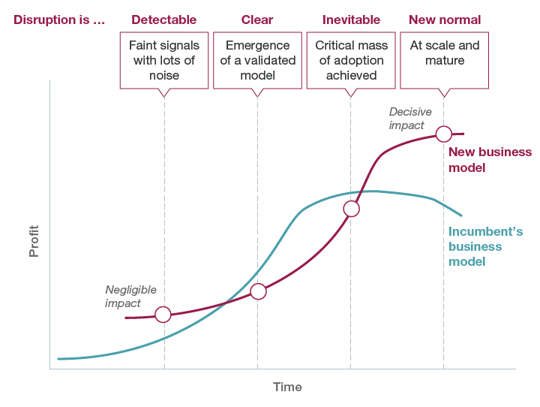
Incumbent to a new journey
Notes:
The image depicts the stages of disruption and the transition from an incumbent's business model to a new business model, highlighting the impact on profits over time.
Stages of Disruption:
Detectable
Description: This initial stage involves faint signals of change with significant noise. Emerging technologies or business models start to appear, but their potential impact is not yet clear.
Impact: Incumbent businesses may notice early signs but often dismiss them due to the noise and lack of clear evidence. The impact on profits is negligible at this stage.
Clear
Description: In this stage, a validated model starts to emerge. The new technology or business model shows signs of viability and potential for growth.
Impact: Incumbents begin to recognize the potential threat or opportunity, but the impact on their profits remains limited. The new business model starts to gain traction and validation.
Inevitable
Description: At this point, the new business model achieves a critical mass of adoption. The market starts to shift more decisively towards the new model.
Impact: The impact on incumbents becomes more noticeable. Their profits may start to plateau or decline as the new model captures market share. The new business model experiences significant growth and increased adoption.
New Normal
Description: The disruption reaches its final stage, where the new business model is at scale and mature. It becomes the dominant model in the market.
Impact: The new business model has a decisive impact on the market, often overtaking the incumbent's model in terms of profitability and relevance. Incumbents may struggle to adapt, and their profits decline as the new model becomes the standard.
Key Concepts:
Profit Over Time: The graph shows the profit trajectories of both the incumbent's business model (blue line) and the new business model (red line) over time.
Incumbent's Business Model: Initially, the incumbent's model maintains steady growth in profits. However, as disruption progresses, profits plateau and eventually decline as the new model gains dominance.
New Business Model: Starts with negligible impact, but as it moves through the stages of disruption, its profitability increases sharply, eventually surpassing the incumbent's model.
Decisive Impact Point: The point where the new business model overtakes the incumbent's model in terms of profitability. This marks a significant shift in the market landscape.
Implications for Incumbents:
Early Detection and Adaptation: Incumbents must be vigilant in detecting early signals of disruption and be willing to explore and invest in new technologies or business models, despite initial noise and uncertainty.
Strategic Flexibility: Being flexible and adaptable in strategy and operations can help incumbents navigate the stages of disruption more effectively.
Innovation and Investment: Continuous investment in innovation and the development of new competencies is crucial to stay competitive in a rapidly changing market.
By understanding and preparing for these stages of disruption, companies can better position themselves to respond to emerging challenges and opportunities, ensuring long-term success and sustainability.
4o

Slide 17
Incumbent to a new journey
Detectable Signals
1998 - PolyGram (top record label) sold to Seagram for $10.6 billion. Why? CD-ROM
1999 - Newspapers
“The Internet is made for classifieds, and classifieds are made for the Internet” - Schibsted
2007 - Telecom New Zealand sold yellow pages for 2.2 billions
2. Change takes hold (Clear)
validated technological and economic drivers
commit to nurturing new initiatives
Missing motivation
Long term threat doesn’t seem dangerous
Netflix (during year 2000s) share fell 80% when focus changed from DVD to streaming.
Notes:
Detectable signal – at this level the signal on the availability of ET is there but are coupled together with greater extend of noises (rumours and others). The above reflects some examples and its outcome.
The sale of PolyGram to Seagram for $10.6 billion in 1998 was primarily motivated by several factors, including the changing landscape of the music industry and the rise of digital technologies such as the CD-ROM.
Digital Disruption: By the late 1990s, the music industry was experiencing significant disruption due to the rise of digital technologies. The introduction of the CD-ROM allowed for new ways of distributing music and multimedia content. Companies like PolyGram were likely exploring strategies to adapt to these changes and stay competitive in the market.
In 2007, Telecom New Zealand sold its Yellow Pages directory business for 2.2 billion New Zealand dollars. This sale was part of a larger trend in the telecommunications industry, where companies were divesting non-core assets to focus on their primary business operations and adapt to changing market dynamics.
The sale of Yellow Pages by Telecom New Zealand can be attributed to several factors:
Shift to Digital: With the advent of the internet and online search engines, traditional print directories like Yellow Pages faced declining relevance and revenue. Consumers increasingly turned to digital platforms to find businesses and services, diminishing the value of print directories.
Stage 2 (Change takes Hold)
Missing motivation – companies are not yet making money at this stages. Tech is still not fully developed, and this leads to missing of motivation.
Company still thinks that they have time and are still confident with their technology.
While Netflix did experience a significant shift in its business model from DVD rentals to streaming, the share price fall by approximately 80% as a direct result of this transition. Instead, the shift from DVD rentals to streaming was part of a strategic evolution that ultimately led to substantial growth for the company.
Transition from DVD Rentals to Streaming: In the early 2000s, Netflix primarily operated as a DVD rental service, sending physical DVDs to customers through the mail. However, with the rise of digital streaming technology and changing consumer preferences, Netflix recognized the opportunity to expand its business into online streaming.
Investment in Streaming: Netflix made significant investments in building its streaming platform, acquiring content licenses, and developing original programming. This strategic shift allowed the company to offer a more convenient and flexible service to its customers, who could now stream movies and TV shows directly to their devices without waiting for DVDs to arrive in the mail.

Slide 18
Incumbent to a new journey
3. Inevitable Transformation
Critical mass of adopters
Superior new technology
Aggressively shifting resources
Overcome lack of in-house capability
Notes:
"Critical mass of adopters" refers to the point at which a new technology, product, or innovation achieves a sufficient number of users or customers to become self-sustaining and reach widespread acceptance or success in the market. This concept is often associated with the diffusion of innovations theory, which describes the process by which new ideas or technologies spread and are adopted by individuals or groups over time.
A "superior new technology" refers to an innovation or advancement that offers distinct advantages over existing technologies in terms of performance, efficiency, usability, cost-effectiveness, or other key metrics. Superior new technologies have the potential to disrupt markets, transform industries, and create significant value for businesses and consumers alike.
"Aggressively shifting resources" refers to a strategic decision made by a company or organization to reallocate its assets, investments, personnel, or other resources in a proactive and assertive manner. This shift may involve moving resources away from underperforming or declining areas and redirecting them toward more promising opportunities, emerging markets, or strategic initiatives.
To overcome a lack of in-house capability, businesses can pursue several strategies:
Outsourcing: When certain tasks or functions require expertise beyond the company's capabilities, outsourcing to external vendors or service providers can be an effective solution. This allows the company to access specialized skills and resources without the need to develop them internally. Common outsourced functions include IT services, marketing, customer support, and manufacturing.
Strategic Partnerships: Collaborating with other companies or organizations through strategic partnerships can help fill gaps in in-house capabilities. By pooling resources and expertise with partners who have complementary strengths, companies can achieve mutual objectives more effectively. Partnerships can involve joint ventures, research collaborations, or distribution agreements.
Training and Development: Investing in training programs for existing employees can help enhance in-house capabilities. By providing employees with opportunities to develop new skills and knowledge, companies can address skill gaps and build a more skilled workforce. Training initiatives can focus on areas such as technical skills, leadership development, or industry-specific knowledge.

Slide 19
Incumbent to a new journey
4. New Normal
Accept reality
First priority: Survival
Second: Sustainability and Growth
Capabilities highly tied to old business
Notes:
Accept the reality of the new normal, the fact that the ET is now in the market capturing popularity.
First priority: Surviving the challenges that comes together with the ET.
Second: Sustainability & Growth –
When a company's capabilities are highly tied to an old business model or technology that may be becoming obsolete or less relevant, it faces the challenge of adapting to changing market conditions. To address this issue, businesses can pursue several strategies:
Strategic Realignment: The company can strategically realign its capabilities to better align with emerging trends or shifting market demands. This may involve diversifying into new product lines or service offerings that leverage existing capabilities in innovative ways or investing in new technologies that can revitalize existing capabilities.
Investment in R&D: Investing in research and development (R&D) can help the company innovate and develop new capabilities that are more aligned with current market needs. By fostering a culture of innovation and experimentation, the company can explore new opportunities for growth and differentiation.

Slide 20
Future Trends in ET
The following(s) are among the blooming future trends of Emerging Technology:
5G Networks – more information at a faster transfer rate.
Autonomous Devices – robots, drones, vehicles.
Augmented Analytics – employ usage of ML and NLP to automate analysis process.
Digital Twins – virtual representation/digital counterpart of a physical objects or process.
Enhanced Edge Computing – distributed computing framework, IoT technologies
Immersive Experiences in Smart Spaces – humans & technology can openly communicate.
Notes:
Future Trends:
5G - Wireless communications systems use radio frequencies (also known as spectrum) to carry information through the air. 5G operates in the same way but uses higher radio frequencies that are less cluttered. This allows for it to carry more information at a much faster rate.
Autonomous Devices - physical form of autonomous technology. Robots, both functional and humanoids, drones and vehicles are a few examples of autonomous devices. Autonomous devices learn from their surroundings and complete tasks without continued human input.
Augmented Analytics - approach of data analytics that employs the use of machine learning and natural language processing to automate analysis processes normally done by a specialist or data scientist.
Digital Twins - virtual representation that serves as the real-time digital counterpart of a physical object or process.
Enhance Edge Computing - distributed computing framework that brings enterprise applications closer to data sources such as IoT devices or local edge servers. This proximity to data at its source can deliver strong business benefits, including faster insights, improved response times and better bandwidth availability.
Immersive Experiences in Smart Spaces - interactive environments where humans and technology can openly communicate with each other in a physical/digital setting. It enables an immersive, interactive and automated experience for people and industry scenarios.

Slide 21
Conclusion
Emerging Technologies are taking over minds, more and more each day.
Existence of chatbots, virtual/augmented reality, blockchain and cloud computing has already shaped life.
Future trends of ET is significantly growing. Its now or so!

Slide 22
Summary / Recap of Main Points
Industrial Revolution
The Primary Industry (IR1.0)
The Secondary Industry (IR2.0)
The Tertiary Industry (IR3.0)
The Quaternary Industry (IR4.0)
What is Emerging Technology?
Characteristics of ET
Advantages & Disadvantages of ET
Role of Data for Emerging Technologies

Slide 23
Question & Answer Session
Q & A

